Slide 1
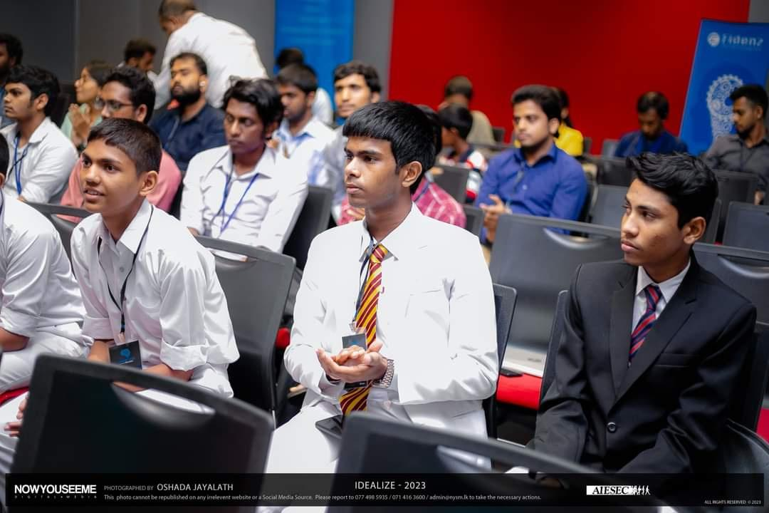


TEAM PROPOSAL
Organized by
AIESEC in University of Moratuwa

Slide 2

IDEALIZE 2024 - Team Proposal
Team Name | ELITES
Category (web/app) | Web Application
School / open | Open Category
Name of the web / app | InternVille
Field of the web / app | Networking and Collaboration for Undergraduate Interns
01

Slide 3
IDEALIZE 2024 - Team Proposal
IDEALIZE 2024 - Team Proposal
Problem Definition, Background & Motivation and Proposed Solution
Problem Definition : Current platforms lack a dedicated focus on connecting undergraduate interns with similar interests for collaboration on projects and startup initiatives.
In Sri Lanka, there is a pressing issue surrounding the availability of intern jobs for undergraduate students. Amidst this challenge, many interns face additional hurdles in finding like-minded peers to collaborate with on projects and startup initiatives. Existing platforms often lack a dedicated focus on facilitating meaningful connections specifically for interns, exacerbating the difficulties they encounter. This fragmentation in the networking landscape not only limits internship opportunities but also hinders interns' ability to explore their entrepreneurial aspirations and develop their skills in a collaborative environment.
.
02

Slide 4
IDEALIZE 2024 - Team Proposal
IDEALIZE 2024 - Team Proposal
Problem Definition, Background & Motivation and Proposed Solution
Background & Motivation : Inspired by the need for a more targeted approach in connecting interns and fostering entrepreneurial activities among students.
The current landscape in Sri Lanka underscores the need for a platform like InternVille. We recognize the importance of fostering connections among interns, especially in the face of limited internship
opportunities. By addressing this need, we aim to empower Sri Lankan interns to leverage their skills and creativity collaboratively, despite the challenges they face. Our motivation stems from the desire to bridge this gap and create a platform that not only caters to the unique needs and aspirations of interns but also helps alleviate the internship scarcity issue in Sri Lanka.
02

Slide 5
IDEALIZE 2024 - Team Proposal
IDEALIZE 2024 - Team Proposal
Problem Definition, Background & Motivation and Proposed Solution
Solution : InternVille, a platform designed to enable interns to connect based on shared interests and abilities, collaborate on projects, and form startups.
InternVille offers a tailored solution to the challenges faced by Sri Lankan interns by providing a dedicated platform for connecting, collaborating, and innovating. Our platform utilizes an advanced matching algorithm to pair interns with similar interests and abilities, ensuring compatibility and fostering effective teamwork. Through virtual collaboration spaces, interns can work together in real-time, facilitating seamless project development. Mentorship programs offer guidance from experienced professionals, helping interns refine their project ideas and navigate the startup landscape.
02

Slide 6
IDEALIZE 2024 - Team Proposal
IDEALIZE 2024 - Team Proposal
App / Web Overview , Uniqueness of Web / App
App/Web overview : InternVille is a web/app platform designed to match interns based on interests and skills, facilitate project collaboration, provide mentorship, and offer startup resources. The primary goal is to create a conducive environment for interns to gather, collaborate, and eventually form startups.
Uniqueness : Differentiates itself from LinkedIn by focusing on interns' needs, including features like project showcases, virtual collaboration spaces, a resource library, gamification, and crowdfunding, all aimed at nurturing startup formation..
02

Slide 7
IDEALIZE 2024 - Team Proposal
IDEALIZE 2024 - Team Proposal
Implementation and Market Plan
Phase 1 : Develop and launch core features, including the matching algorithm and project showcases. -
Phase 2 : Integrate mentorship programs and expand the resource library.
Phase 3 : Introduce gamification, job board, and crowdfunding to support startup formation.
Implementation
03

Slide 8
IDEALIZE 2024 - Team Proposal
IDEALIZE 2024 - Team Proposal
Implementation and Market Plan
Launch Strategy: Partnerships with universities and student organizations to build an initial user base.
Promotion: Social media campaigns, webinars, and participation in college fairs to attract more users.
Long-term Goals: International expansion, continuous feature updates based on user feedback, and fostering a global network of student startups.
Marketing Plan
03

Slide 9
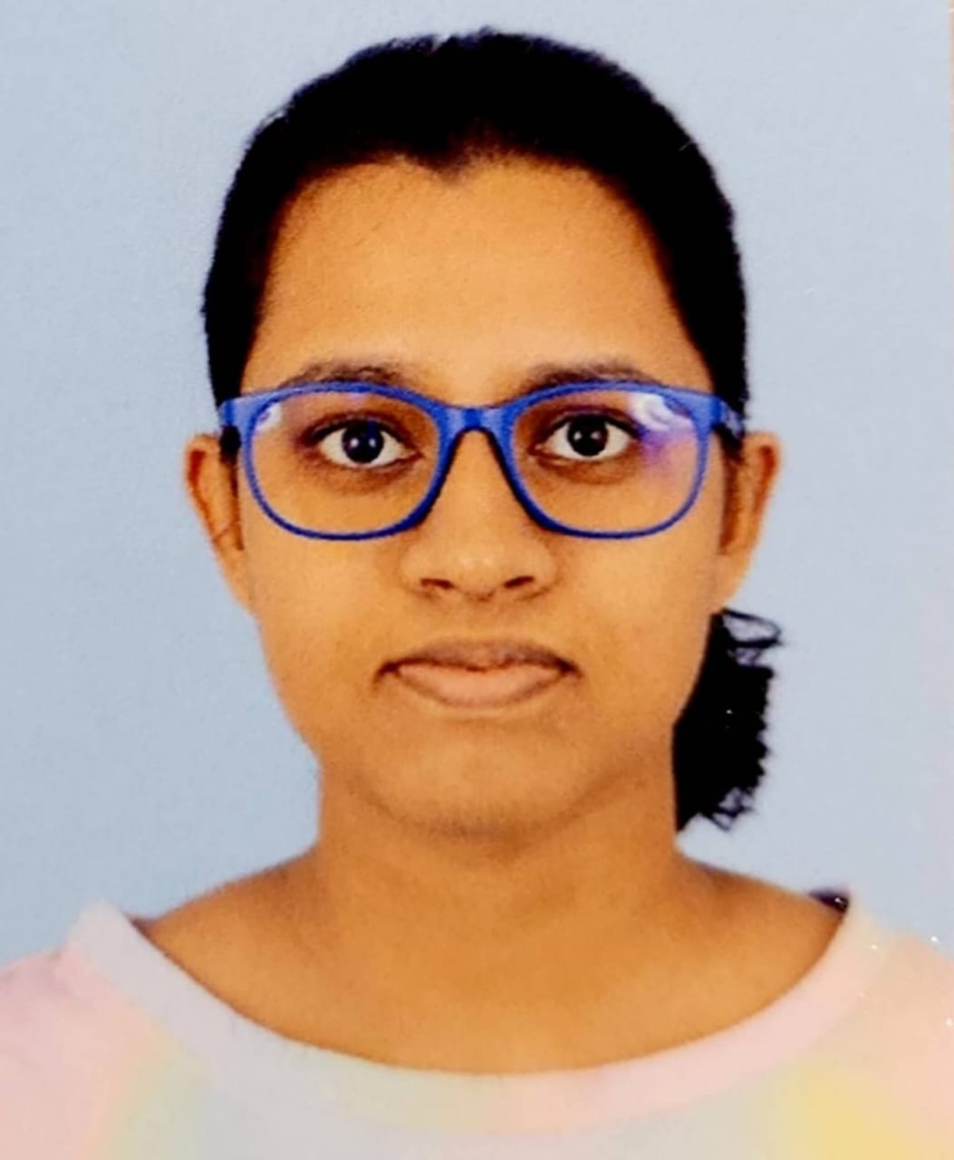
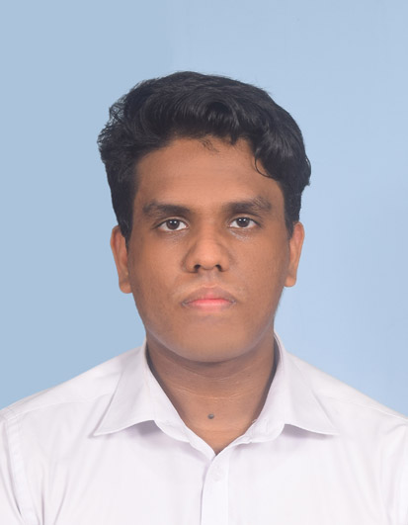
IDEALIZE 2024 - Team Proposal
IDEALIZE 2024 - Team Proposal
Team Details
Sandali Janeesha Sandagomi
Sri Lankan Institute Of Information Technology
200371411362
Sandalisandagomi@gmail.com
0 71 663 9395
Pasandul Hesara Perera
Sri Lankan Institute Of Information Technology
200321511777
magalagepasandul@gmail.com
0 77 638 4916
04

Slide 10
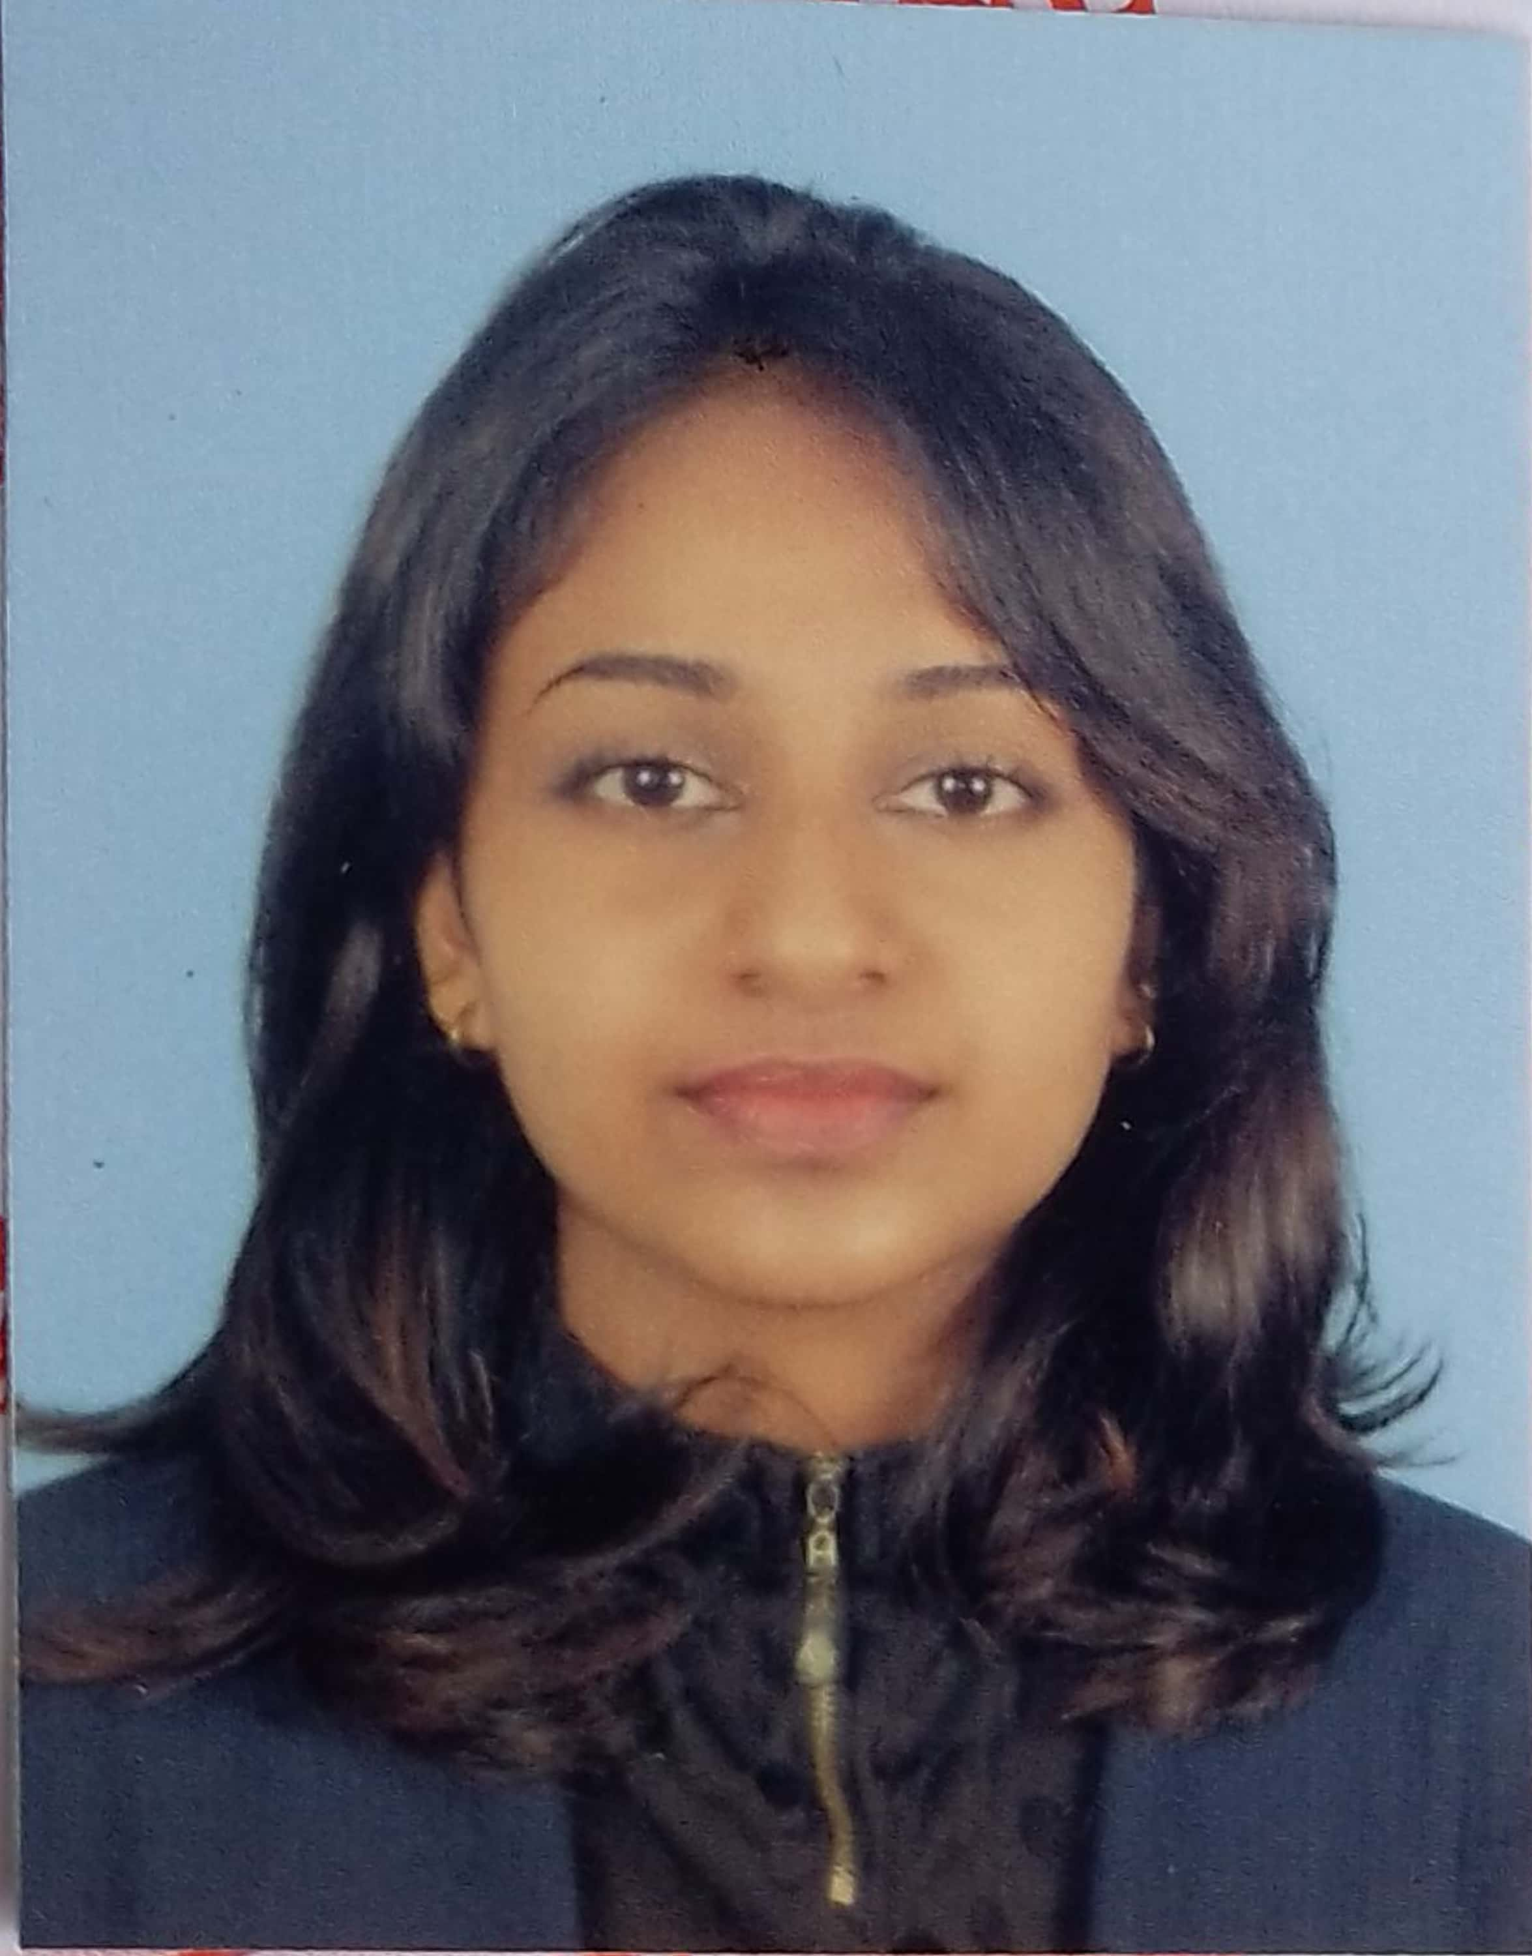
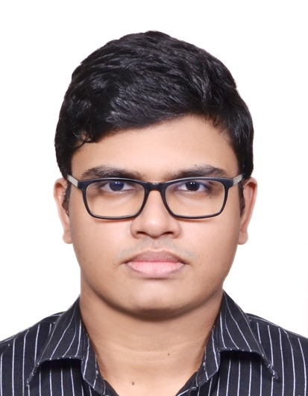
IDEALIZE 2024 - Team Proposal
IDEALIZE 2024 - Team Proposal
Team Details
Himasha Devindi Hettiarachchi
Sri Lankan Institute Of Information Technology
200355201084
himasha221d@gmail.com
0755852632
Sandil Helitha Perera
Sri Lankan Institute Of Information Technology
200329300730
sandilperera2003@gmail.com
0 77 031 0080
05

Slide 11
IDEALIZE 2024 - Team Proposal
IDEALIZE 2024 - Team Proposal
Team Details
Dilusha Chamika Dissanayaka
Sri Lankan Institute Of Information Technology
200326711517
dilushachamika0@gmail.com
0 76 160 9595
06

Slide 12

IDEALIZE 2024 - Team Proposal
IDEALIZE 2024 - Team Proposal
Our App: Not Just Another LinkedIn
InternVille is a unique platform specifically designed to foster innovation, collaboration, and entrepreneurship among interns. Unlike LinkedIn, which focuses on professional networking and job seeking, InternVille emphasizes project development, mentorship, and startup formation, providing a comprehensive ecosystem for turning ideas into successful businesses.
Features and Benefits:
Advanced Matching Algorithm: Ensures high compatibility between collaborators, fostering effective teamwork.
Project Showcases: Allows users to present their projects, receive feedback, and attract potential team members.
Virtual Collaboration Spaces: Provides tools for real-time teamwork, facilitating seamless project development.
Mentorship Programs: Offers guidance from experienced professionals to help interns develop their projects into viable startups.
Resource Library: A comprehensive collection of educational resources to support skill development and project execution.
Gamification and Challenges: Engages users through competitions and rewards, motivating them to innovate and collaborate.
Crowdfunding Platform: Provides funding opportunities for promising projects, enabling the transition from idea to startup.
07

Slide 13


IDEALIZE 2024 - Team Proposal
IDEALIZE 2024 - Team Proposal
Our App: Not Just Another LinkedIn
User Journey:
Sign Up: Create a profile based on interests, skills, and startup aspirations.
Matchmaking: Connect with like-minded interns who share similar abilities and interests.
Collaboration: Utilize virtual workspaces and tools to work on projects together.
Mentorship: Access guidance and advice from experienced mentors to refine project ideas.
Showcase and Feedback: Present projects, receive feedback, and iterate on ideas.
Funding and Startup Formation: Seek crowdfunding for projects, form teams, and launch startups.
08

Slide 14
IDEALIZE 2024 - Team Proposal
IDEALIZE 2024 - Team Proposal
Our App: Not Just Another LinkedIn
Future Vision:
We plan to expand InternVille globally and continuously add new features based on user feedback. Our goal is to foster innovation and entrepreneurship among interns, contributing to the global startup ecosystem. We'll also partner with educational institutions and industry leaders to provide more opportunities and resources for our users, enhancing the web app's capabilities.
Expansion: Broaden our user base internationally, connecting interns from around the world.
New Features: Continuously add new features based on user feedback to enhance the platform's effectiveness in supporting startup formation.
Impact: Contribute significantly to the global startup ecosystem by fostering innovation, collaboration, and entrepreneurship among interns.
Partnerships: Forge strategic partnerships with educational institutions, accelerators, and industry leaders to provide more opportunities and resources for our users.
09

Slide 15
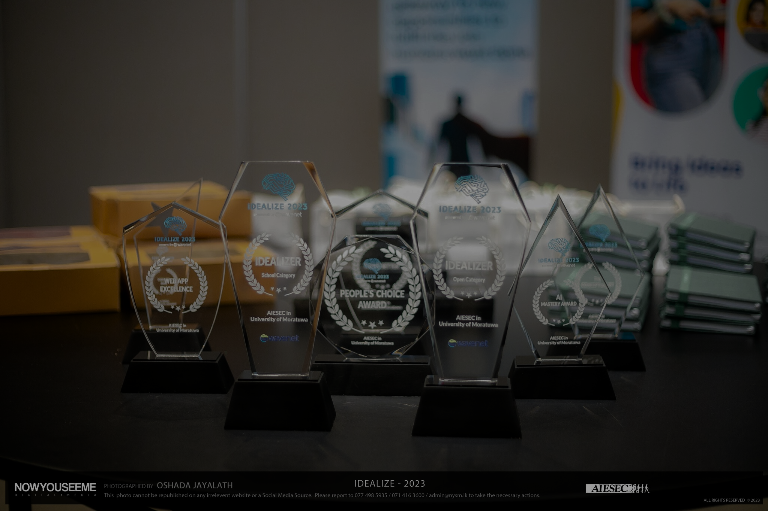
THANK YOU
Organized by
AIESEC in University of Moratuwa

